Slide 1
Computers and Learning
EDC&I 510

Slide 2
Initial Questions
Your earliest memories of computers used in education:
What were they used for? (activities, software, etc.)
Who used them? (students, teacher; individuals or groups)
How much?
What were the results (for you, others)?

Slide 3
Papert vs. Pea
Do you recall a situation where a computer-based activity (programming, debugging, spreadsheet construction, etc.,) influenced your thinking in a different domain? What was it? How did the connection occur to you?

Slide 4
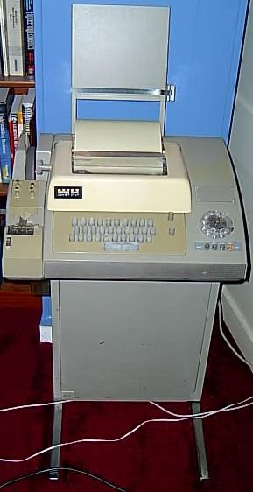
Early Efforts
Suppes and others: Visions of what computers could offer
Branching programs
Radical individualization
Enthusiasm for artificial intelligence
But….

Slide 5
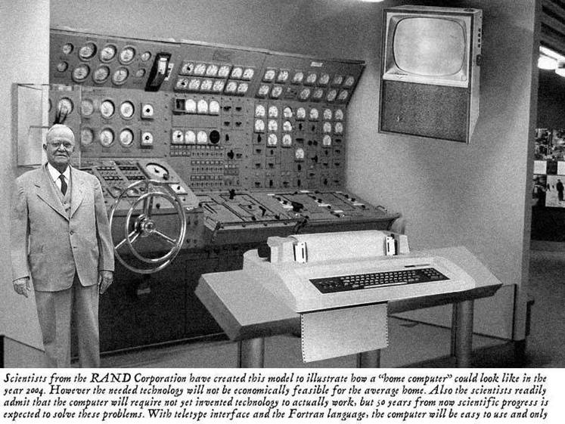

Slide 6
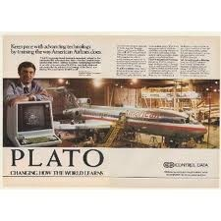
PLATO
Early example of the transition from PI (programmed instruction) to CAI (computer-assisted instruction)
Large system with many programs
Many innovations
Message boards
Games
“Avatar”

Slide 7
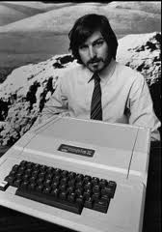
Until…
Advent of personal computers in late 1970s, 1980s
Usefulness for common business tasks (writing, organizing data)
Early ed software = fairly primitive (workbooks, etc.)

Slide 8
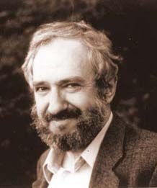
Papert’s New Vision
Not the computer as instructor, but as the object of the child’s work
Deeply rooted in Piagetian psychology
Originated much of the current discussion of “constructivism”

Slide 9
LOGO
“The kid’s programming language”
Papert’s conviction: kids would easily transfer problem solving skills from LOGO to other settings, tasks

Slide 10
The LOGO Debate
Transfer happens, but not automatically
Structure (“scaffolding”) is key and varies by domain, problem type
Complexity of learning and of school settings make it problematic for a single vision to take hold and guide further development

Slide 11
The Broader Surround (early 1990s)
Software development:
Slow; initial assumption: “Teachers will write their own software!” (Not).
A few good, experimental companies and consortia created interesting products
Oregon Trail (MECC - Minnesota Educational Computing Consortium)
Rocky’s Boots (The Learning Company)
Where in the World Is Carmen Sandiego? (Brøderbund Software)

Slide 12
Software Firms
Riverdeep/Houghton Mifflin
Renaissance Learning
Apex Learning (Seattle-based)
Facet Innovations/Diagnoser Project (Seattle-based)
And software that came out of research projects – e.g., Geometer’s Sketchpad

Slide 13
Issues of Interest, 1996-2002
Concerns re “digital divide” (H.J. Becker studies)
Lab vs. classroom placement
Access by boys vs. girls
Costs (implied changes in overall model of school capitalization)
Public enthusiasm (first ed tech innovation pushed by public, not by educators)
Al Gore invents the Internet…

Slide 14
1990s: Rapid Increase in Connectivity

Slide 15
Initial Concerns re Digital Divide
Were real (see following)
BUT: Most states, plus Fed Govt, quickly recognized this and put policies in place to address
Federal E-Rate program spurred access
“Universal service” line on your phone, cell phone, etc., bill

Slide 17
Kids Working with Computers
In school vs. out of school uses
Debate about internet access in schools
Collaborative vs. individual uses; roles
Cf.: ““I'm the thinkist, you're the typist” (1984 article by Sheingold & Hawkins)
“Ubiquitous” computing in schools
Laptops, netbooks, iPads, etc.

Slide 18
What Mattered
“It’s the design, stupid!”
Early on, assuring equal access was important
Gradual evening out of SES-group access by early 2000s (but rural access is still an issue)
Mass application and use of computerized curricula does lead to improved scores
But because of the design, not the technology
Ability to repurpose materials and facilitate independent student work
These provided clear organizational advantages

Slide 19
What Didn’t Matter So Much
Hardware
Machines by themselves can be used in lots of ways, only some of them beneficial
Programming
Skills don’t automatically transfer without lots of scaffolding
Internet Access
Without guidance and sophistication, quantity does not equal quality

Slide 20
Questions that Faded with Time
Value of one platform vs. another (Apple vs. IBM/MSFT, etc.)
“Teacher Resistance” (vs. imagination)
Boys vs. girls

Slide 21
What Was Left Unanswered
Internet
We’re still trying to figure out how widely available information affects the common “canon” of cultural wisdom
“The Way We Work Now” (21st c. skills arguments)
But is it the way we should learn now?
Constructivism vs. instructionism
Does the value of student activity warrant the added complexity and uncertainty?

Slide 22
Games
Projective Stance
Mead’s Social Interactionism
Vygotsky’s activity theory

Slide 23
Social Media: Questions for Next Week
Are kids really fluent and smart users of interactive technology and social media?
Where does their expertise shine and where do they need help?
If social media bring down barriers based on social position and attributed expertise, what are implications for traditional education?
If social media facilitate extensive peer-peer interaction, how do we “design” that to facilitate learning?

Slide 24
Social Media: Questions for Next Week II
“New Literacies” – How important in relation to “old” literacy?
Types of information typically accessed, shared via social networks – Implications for education? Learning?
Brief /Visual Messages for Learning?
What does it mean to use YouTube or Twitter for educational ends?

